Slide 1
Database Programming
Chapter 4 (Part 1)

Slide 2
What Are You Going To Learn?
At the end of this lesson, you will be able to:
Explain data-driven web page.
Use ASP.NET database namespaces and custom-built objects (ADO.NET)
Discuss the issues in data-driven page
Apply parameterized query method.
Create, retrieve, update and delete (CRUD) records on database.

Slide 3
Data-Driven Web Page (Advantages)
Web pages using databases and other sources of data to turn static web pages into dynamic data-driven web pages.
Maintainability
easier to maintain data and keep it up-to-date.
Reusability
information in databases can easily be backed up and reused as required.

Slide 4
Data-Driven WebPage(Advantages)
Data context
database allows to define relationship and rules for the data in the database.
Quality and timeliness of content
databases are optimized for the storage and retrieval of data. They allow you to use and update information on live Web site almost in real time.

Slide 5
Disadvantages
it takes a little more time to write code to access the database.
Development time
Dependency on the database
The whole Web site will fail if the database fail for some reason.

Slide 6
Disadvantages
Database round-trip
The round-trip between client and server means a slight reduction in performance
Cost
Full enterprise-level database solution are quite expensive.
Notes:
-Database roundtrip - when a user request a dynamic page that requires data from a database, the Web server must first make request to the database for the necessary data, and then wait for it to arrive before it can assemble and send the page the user requested.

Slide 7
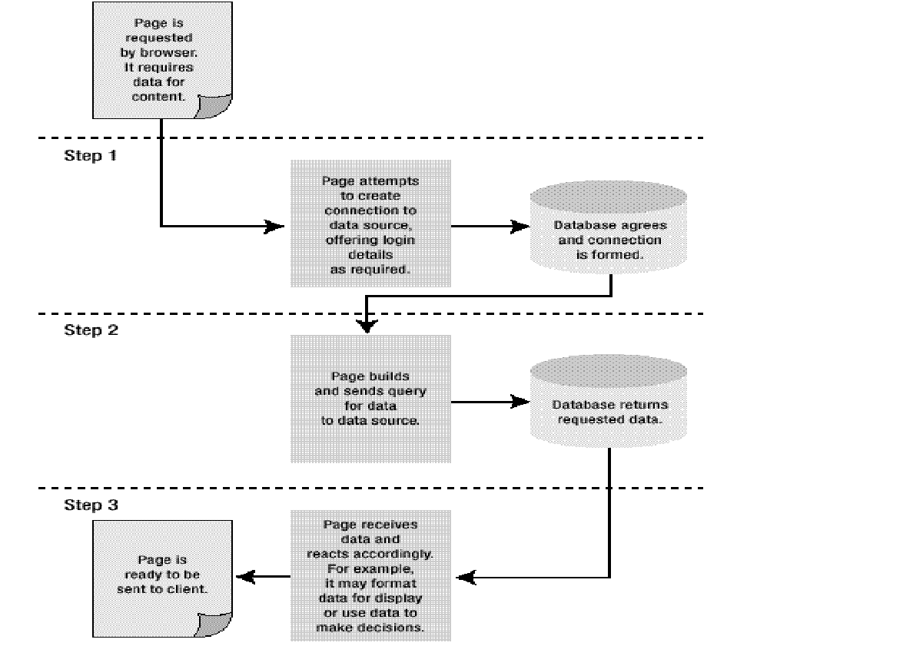
How Does The Web Site Get The Data?

Slide 8
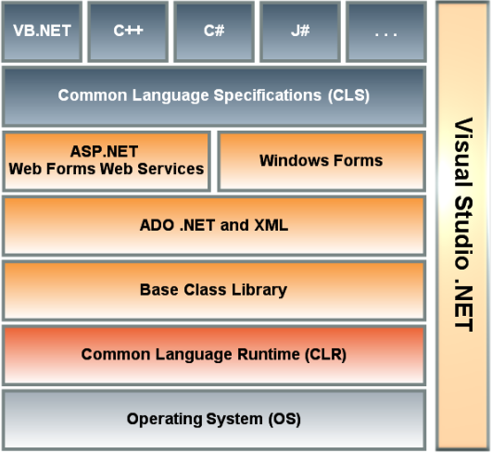
ADO.NET – ASP.NET Data Objects
ADO.NET is a part of the base class library that is included with the Microsoft .NET Framework.

Slide 9
ADO.NET – ASP.NET Data Objects
A set of computer software components that can be used by programmers to access data and data services.
commonly used by programmers to access and modify data stored in relational database systems, though it can also be used to access data in non-relational sources.
ADO.NET Data Services has been renamed as WCF data services in 2009 (aka Astoria).
Notes:
ADO.NET data services has been renamed as WCF data services in 2009 (aka Astoria). It exposes data, represented as Entity Data Model (EDM) objects, via web services accessed over HTTP.
WCF – Windows Communication Foundation

Slide 10
ADO.NET – Namespaces
The .NET framework contains several namespaces with dozens of classes devoted to database access.
Microsoft has created separate namespaces that are optimized for working with different data providers (different types of databases).
Notes:
Namespace: It is a logical grouping of the names used within a program. In .NET, it shows a library of classes.
A namespace uniquely identifies a set of names so that there is no ambiguity when objects having different origins but the same names are mixed together.
For example
System.Windows.Controls.TextBox
System.Web.UI.WebControls.TextBox
are having the same identifier TextBox but with different namespace.

Slide 11
ADO.NET - Namespaces
System.Data.SqlClient:
Contains classes for connecting to Microsoft SQL Server version 7.0 or higher
System.Data.OleDb:
Contains classes for connecting to a data source that has an OLE DB provider (such as Ms Access).

Slide 12
ADO.NET - Namespaces
System.Data.Odbc:
for a data source that has an ODBC driver.
System.Data.OracleClient:
for Oracle database server.
System.Data.SqlServerCe:
for SQL Server CE.
Notes:
SQL ServerCE: SQL Server Compact Edition

Slide 13
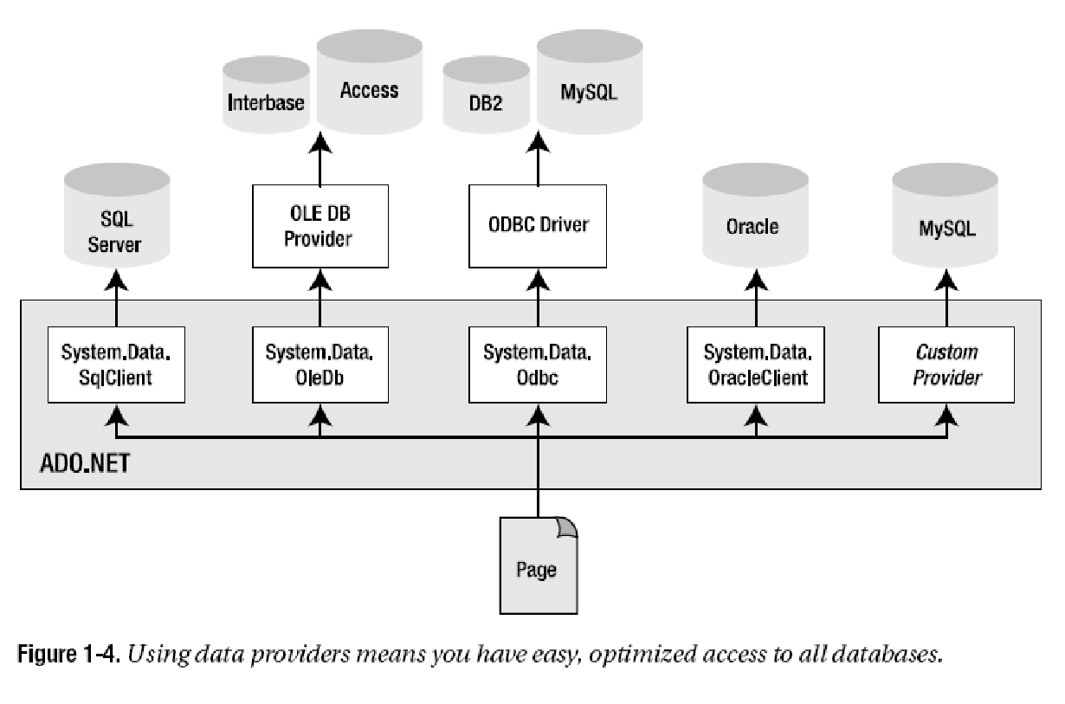

Slide 14
ADO.NET - Common Data Classes
Each data source has its own set of provider objects, but they each have a common set of utility classes as follow:
Connection object:
Provides a connection used to communicate with the data source.
Command object:
Used to perform some action on the data source, such as reading, updating, or deleting relational data.
DataAdapter object:
A bridge used to transfer data between a data source and a DataSet object

Slide 15
ADO.NET - Common Data Classes
DataReader object:
Used to efficiently process a large list of results one record at a time. It allows records to be accessed in a read-only, forward-only mode, i.e., records have to be accessed in sequential order; they can neither be randomly accessed nor can a record which has been processed previously be accessed again.
Parameter object:
Describes a single parameter to a command.

Slide 16
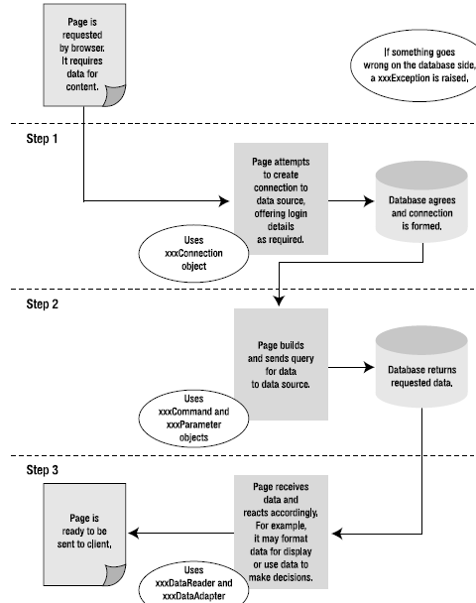

Slide 17
Question
Identify the data objects (connection, command, Parameter, DataReader) that are needed by:
A Search engine page(connection, command,parameter,reader)
A login page.(connection, command, parameter)
A page that allows you to add a new product's details.(connection, command, parameter)
A page that allows you to edit your personal details.
(connection, command, parameter)
Notes:
connection, command, Parameter, DataReader
connection, command, Parameter, DataReader
connection, command, Parameter
connection, command, Parameter

Slide 18
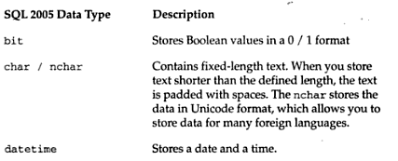
Which Data Type to Use?
Example:
Use bit to store 0/1 (e.g. 0=absent; 1=present)
Use char to store student’s registration number
Use nchar to store Chinese character in fixed length

Slide 19
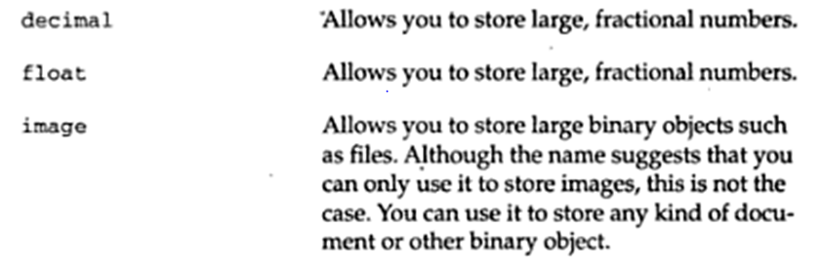
Which Data Type to Use?
Decimal storage size is 17 bytes. Maximum precision and scale goes up to - 10³⁸ +1 through 10³⁸ - 1. Used for fixed precision and scaled numeric data. E.g. decimal(5,2) stores 123 as 123.00 (precision of 5, scale of 2)
Default float precision is 15, storage size is 8 bytes.
Image stores variable-length binary data from 0 through 2³¹-1 (2,147,483,647). Will be obsolete in the future (avoid using this)
Notes:
Precision is the number of digits in a number. Scale is the number of digits to the right of the decimal point in a number

Slide 20
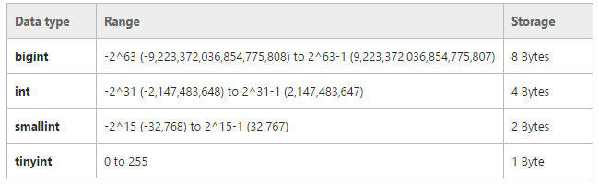
Which Data Type to Use?
Notes:
Precision is the number of digits in a number. Scale is the number of digits to the right of the decimal point in a number

Slide 21
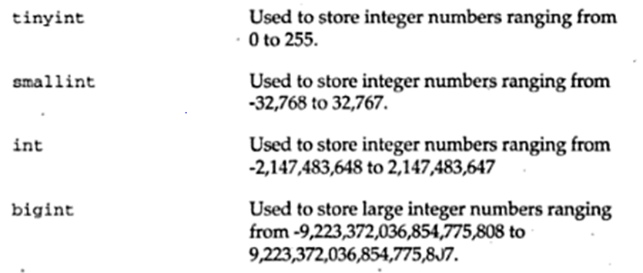
Which Data Type to Use?
(1 byte)
(2 bytes)
(4 bytes)
(8 bytes)
What data type would you use to store Bill Gate’s net worth (income) in 2014?
Notes:
Bill Gate’s net worth is USD 78 Billions (78,000,000,000) in 2014 (Forbes).

Slide 22
Which Data Type to Use ?
Selecting the appropriate data type for your application will help your database to function more correctly.
Too large of a data type : wasting space
Too small of a data type: artificial ceiling
incorrect type : required data type conversion
incorrect type : makes reporting more difficult
Example: Zip code, money
Notes:
Artificial ceiling: For instance for float, it has a fixed precision, it can’t store the number as big as you want, and you may lose the precise information that you need. E.g. 0.123456, it may store 0.12346. Another example, if and infinite division such as 1/3 = 0.33333333333333333... then it depends on which data type you use to return a number with certain precision.
Remark: The bigger the info it stores, the more memory is consumed.

Slide 23
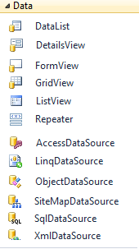
Connecting to Database in ASP.NET
A simple way is to use data source controls, which allow you to encapsulate data access in a control that you can configure with connection and query information.
Namespace: System.Web.UI.WebControls
data bound controls
data source controls

Slide 24
Data Source Control
collection of Web controls designed to provide a declarative approach to accessing and modifying data.
enable rich capabilities for retrieving and modifying data, including querying, sorting, paging, filtering, updating, deleting, and inserting.
you can work with data without having to write a lick of data access code.

Slide 25
Data Source Control
The built-in data source controls
SqlDataSource
AccessDataSource
ObjectDataSource
XmlDataSource
SiteMapDataSource
LinqDataSource
EntityDataSource (not in syllabus)

Slide 26
SqlDataSource Control
The "Sql" in the control name does not refer to Microsoft SQL Server, but rather the SQL syntax for querying relational databases.
SqlDataSource control can be used to access not only Microsoft SQL Server databases, but Microsoft Access databases, Oracle databases and basically any OLE-DB or ODBC-compliant data store.

Slide 27
Connecting to Database in ASP.NET
Alternatively, we can code to access the database for customized requirements (which cannot be fulfilled by the Data Access Web Controls.
private static void ReadOrderData(string connectionString)
{
string queryString = "SELECT OrderID, CustomerID FROM dbo.Orders;";
using (SqlConnection connection = new SqlConnection( connectionString))
{
SqlCommand command = new SqlCommand( queryString, connection);
connection.Open();
SqlDataReader reader = command.ExecuteReader();

Slide 28
System.Data.SqlClient
The System.Data.SqlClient namespace include the following classes :
SqlConnection:
Represents an open database connection to a database.
SqlCommand:
to execute a SQL statement against a SQL Server database.

Slide 29
System.Data.SqlClient (cont..)
SqlParameter:
Pass parameter values to a SQL command. Parameters are commonly used to limit the number of row retrieved by a Select statement
SqlDataReader:
To create a data reader object, which provides an efficient way to read the rows in a result set resulted by a database query
SqlDataAdapter:
to provide a link between a database and dataset

Slide 30
Common Database Task
In this section, you will learn to perform common database tasks using the ADO.NET’s data objects:
Create & open a database connection.
C: Create/Add new database records.
R: Retrieve & display database records.
U: Update existing database records.
D: Delete database records.

Slide 31
Configuring Web.config
placed inside the <Configuration> tag
<?xml version="1.0"?>
<configuration>
<connectionStrings>
<add name=" WebConfigConString" connectionString="Data Source=(LocalDB)\v11.0;AttachDbFilename=|DataDirectory|\Authors.mdf;Integrated Security=True“ providerName="System.Data.SqlClient" />
</connectionStrings>
<system.web>
</system.web>
</configuration>
placed before the <system.web> tag

Slide 32
Storing ConnectionString in web.config File
you can secure the connection string using encryption.
Question:
Discuss another advantage of storing the connection string in the web.config file.
Notes:
you can easily change the server name, database, or authentication information without editing individual Web pages
http://www.codeproject.com/Tips/795135/Encrypt-ConnectionString-in-Web-Config
cd C:\Windows\Microsoft.NET\Framework\v4.0.30319
ASPNET_REGIIS -pef "connectionStrings" "F:\TARUC\2113_201605\Chapter4\C4\C4“
http://forums.asp.net/t/1191310.aspx?web+config+connection+string+encryption+using+DPAPI+problem+

Slide 33
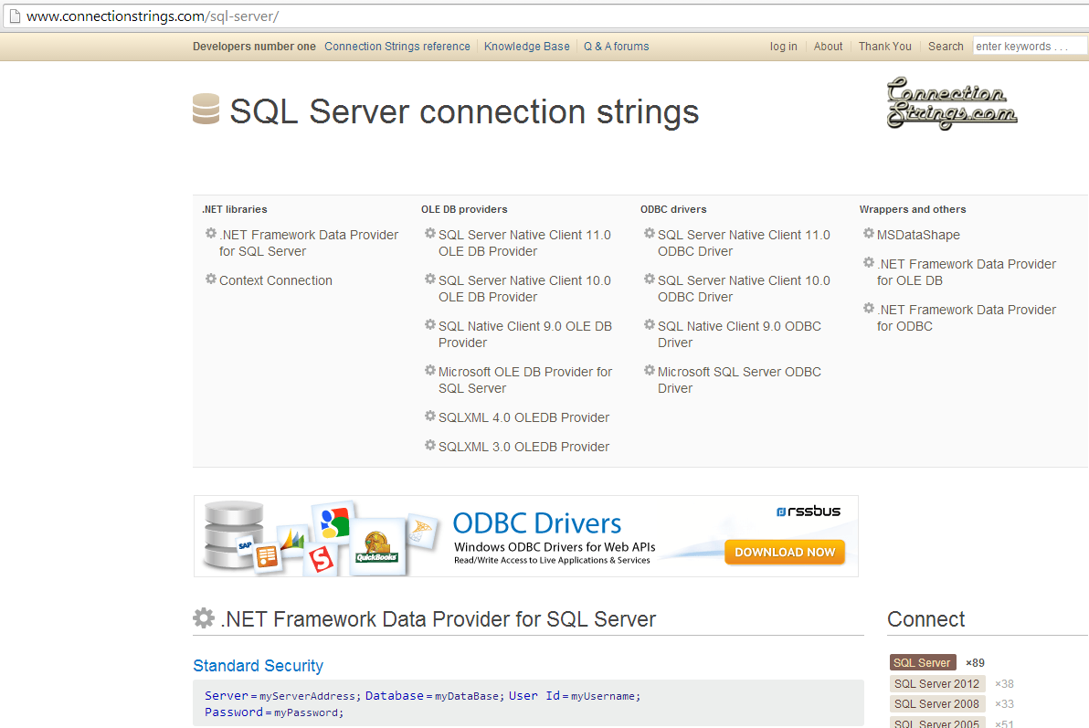
Reference: connectionstrings.com

Slide 34
DEMO
Creating New Database Table
Using SQL Server Express

Slide 35
Retrieve & Display Database Records
4 steps to retrieve database records:
Create & open a database connection.
Create SQL Select statement and SqlCommand object.
Execute the Command to retrieve and store the records in the memory (with DataReader or variable)
Display the results of the query.
Close the database connection

Slide 36
Retrieve & Display Database Records
Step 1: Create & open a database connection
First, include the namespace
Method 1: Place the connection string on Web Form
using System.Data.SqlClient;
SqlConnection con = new SqlConnection(@"Data Source=(LocalDB)\v11.0;AttachDbFilename=|DataDirectory|\Authors.mdf;Integrated Security=True");

Slide 37
Step 1: Create & open a database connection
Method 2: The connection string is in the web.config
string strCon = ConfigurationManager.ConnectionStrings[" WebConfigConString "].ConnectionString;
SqlConnection con = new SqlConnection(strCon);
Web Form
<?xml version="1.0"?>
<configuration>
<add name=“WebConfigConString" connectionString="Data Source=(LocalDB)\v11.0;AttachDbFilename=|DataDirectory|\Authors.mdf;Integrated Security=True"/>
<system.web>
</system.web>
</configuration>
web.config

Slide 38
Step 1: Create & open a database connection
To open a database connection
Syntax:
Example
Similarly, to close a database connection
connectionName.Open();
con.Open(); //con is created in Step 1
con.Close();

Slide 39
Retrieve & Display Database Records
Step 2: use the Select SQL statement to query the records from the connected database.
Syntax (just in case you have forgotten about it ☺ ):
Example
Select column1, column2…
From table1, table2….
Where search_condition
string strSelect = “Select fname, lname
From Students where lname = ‘Wong’”;

Slide 40
Retrieve & Display Database Records
Step 2: Create an SqlCommand object
Example
The SQL Select Statement created in Step 2
SqlCommand cmdXXX =
new SqlCommand(SQL_statement, connection_object);
the connection object created in Step 1
SqlCommand cmdSelect=
new SqlCommand(strSelect, con);

Slide 41
Retrieve & Display Database Records
Step 3: Execute Command to retrieve records
Method 1: 1 or more records are returned
Use SqlDataReader object (to temporary store the records that retrieved by the Command object).
Syntax:
Example
The command object is created in Step 2
SqlDataReader dtrXXX = commandName.ExecuteReader();
SqlDataReader dtrStud= cmdSelect.ExecuteReader();

Slide 42
DataReader
It represents forward-only stream of database records.
It processes ONE single record at a time.
Once you pass a records, there is no going back.
It does not have a property that returns a count of records.

Slide 43
DataReader – Read()
Use Read()method to fetch the next record in the stream.
To display all the records returned from a query, use loop to Read the datareader until the end of the stream.
SqlDataReader dtrStud= cmdSelect.ExecuteReader();
while (dtrStud.Read())
{
Response.Write(dtrStud["lname"] + dtrStud["fname");
}

Slide 44
DataReader - HasRows
Checking whether any row (of records) is returned .
Unlike the Read() method, it does not advance the DataReader to the next row
if(dtrStud.HasRows)
{
while (dtrStud.Read())
{
Response.Write(dtrStud["lname"] + dtrStud["fname");
}
}
else
Response.Write ("No records retrieved");

Slide 45
Retrieve & Display Database Records
Step 3: Execute Command to retrieve records
Method 2: Only 1 data is returned
Using a variable to store the data is sufficient.
Example: Retrieve a user’s password.
Retrieve a single value concern aggregate functions:
SQL Server Express supports several aggregate functions in a SQL statement, such as count(*), sum(field), avg( ), min( ), max( ).
Notes:
Example:
Select count(*) From Product;
Select Min(Benefits) From Employees Where Position = ‘Manager’;
Select sum (s.qty * p.unit_price) From Product p, sell s Where p.Pid = s.Pid;

Slide 46
Retrieve & Display Database Records
use the ExecuteScalar ( ) method (from SqlCommand class). This method returns object type.
ExecuteScalar ( ) returns the value of the first column of the first row returned by a query.
string strCountProd = "Select count(*) From Product";
SqlCommand cmdCount = new SqlCommand(strCountProd, con);
int count= (int)cmdCount.ExecuteScalar();

Slide 47
Question
Can you forecast the potential problem in this code?
ExecuteScalar( ) returns the value of the first column of the first row returned by a query.
string strGetPW = "Select * From Students
where username=‘Eric Tan’ ";
SqlCommand cmdGetPW = new SqlCommand(strGetPW, con);
object getPW= cmdGetPW.ExecuteScalar();
string password;
if(getPW != null)
password = getPW.ToString();
else
Response.Write(“Invalid username");
Notes:
1) The data returned from the execution may not be the password (as the select statement selected the whole record)

Slide 48
DEMO
Retrieving Database Record

Slide 49
Question
What are the general procedures to retrieve database record(s)?
What are the differences between ExecuteReader() and ExecuteScalar() methods?
What execute statement to use?
To retrieve the price when the product code is entered.
To retrieve the shops nearby based on user’s current location
To retrieve the top 10 movies in this week

Slide 50
Retrieving Information Based on User’s Input
2 methods:
Using string concatenation.
Using the Parameterized query method

Slide 51

Retrieving Information Based on User’s Input
Method 1: Using String Concatenation Method
the SQL Select statement is concatenate with value that pass from the server control.
strSelect = "Select lastname From Author Where firstname='" + txtFirstname.Text + "'";
txtFirstname

Slide 52
Retrieving Information Based on User’s Input
Method 2: Using Parameterized Query Method
Pass parameters with SqlParameter (from SqlCommand class)
Syntax
Example
Commandobj.Parameters.AddWithValue (“@Param”, value);
strSelect = "Select * from Student Where fname=@firstname“;
SqlCommand cmdSelect = new SqlCommand(strSelect, con);
CmdSelect.Parameters.AddWithValue(“@firstname”, “Alex”);
Notes:
http://www.w3schools.com/sql/sql_injection.asp

Slide 53
Using Parameterized Query Method
We do not need to specify the data type of the parameter, which it is automatically inferred from the value assigned to the parameter.
In the example above, the value Fred is a String, the data type varchar is inferred.
CmdSelect.Parameters.AddWithValue(“@firstname”, “Fred”);

Slide 54
Using Parameterized Query Method
Advantages:
Using parameterized query makes tasks for doing query much easy and simple
Your query is more readable
Preventing SQL Injection attacks

Slide 55
DEMO
SQL Injection

Slide 56
Issues in Database Programming: SQL Injection
is a code injection technique that exploits a security vulnerability occurring in the database layer of an application.
The vulnerability is present when user input is either incorrectly filtered for string literal escape characters embedded in SQL statements or user input is not strongly typed and thereby unexpectedly executed.

Slide 57
Issues in Database Programming: SQL Injection
effective measures that can be adopted to prevent SQL injection attacks:
Prevent unauthorized access
limit the permissions that are granted to the database user account that the application uses.
Avoid displaying the actual database errors or messages to the end users.
Avoid disclosing technical errors

Slide 58
Issues in Database Programming: SQL Injection
Validate user input
stripping off the potentially malicious characters; Check for known good data by validating for type, length, format, and range.
Use parameterized query
Always use parameterized SQL queries and stored procedures rather than string concatenation

Slide 59
SQL Injection and Parameterized Query
Parameterized query is considered the best defense against SQL injection
Provide type checking and length validation
provide type checking and length validation.
Values outside of the range trigger an exception.
The input is treated as literal value
SQL Server does not treat the input value as executable code.

Slide 60
DEMO
Using Parameterized Query

Slide 61
Next Week
CUD (Create, Update and Delete) data from the database
Advanced Data Handling

